Slide 1
QT UI Widgets and Layout_2S
Teleca Chengdu
Author: Johnny Liu
Date: July 22, 2010
Version: 1.1

Slide 2
Have five parts about Qt Widget and Layout
1.QWidget (19 July)
2.QAction(19 July)
3.QMainWindow(19 July)
4.QEialog (22 July)
5.QLayout (22 July)
Today is 4 and 5 parts.

Slide 3
1. QDialog
1) The QDialog class is the base class of dialog windows.
2) A dialog window is a top-level window mostly used for short-term tasks and brief communications with the user. QDialogs may be modal or modeless. QDialogs can provide a return value , and they can have default buttons.
3)QDialogs can also have a QSizeGrip in their lower-right corner, using setSizeGripEnabled(), it holds whether the size grip is enabled.

Slide 4
QDialog
4) Note that QDialog (an any other widget that has type Qt::Dialog) uses the parent widget slightly differently from other classes in Qt. A dialog is always a top-level widget, but if it has a parent, its default location is centered on top of the parent's top-level widget (if it is not top-level itself). It will also share the parent's taskbar entry.
5) Use the overload of the QWidget::setParent() function to change the ownership of a QDialog widget. This function allows you to explicitly set the window flags of the reparented widget; using the overloaded function will clear the window flags specifying the window-system properties for the widget (in particular it will reset the Qt::Dialog flag).

Slide 5
Modal Dialogs
1) A modal dialog is a dialog that blocks input to other visible windows in the same application. Dialogs that are used to request a file name from the user or that are used to set application preferences are usually modal. Dialogs can be application modal (the default) or window modal.
2) When an application modal dialog is opened, the user must finish interacting with the dialog and close it before they can access any other window in the application. Window modal dialogs only block access to the window associated with the dialog, allowing the user to continue to use other windows in an application.

Slide 6
Modal Dialogs
3) The most common way to display a modal dialog is to call its exec() function. When the user closes the dialog, exec() will provide a useful return value. Typically, to get the dialog to close and return the appropriate value, we connect a default button, e.g. OK, to the accept() slot and a Cancel button to the reject() slot. Alternatively you can call the done() slot with Accepted or Rejected.
4) An alternative is to call setModal(true) or setWindowModality(), then show(). Unlike exec(), show() returns control to the caller immediately. Calling setModal(true) is especially useful for progress dialogs, where the user must have the ability to interact with the dialog, e.g. to cancel a long running operation. If you use show() and setModal(true) together to perform a long operation, you must call QApplication::processEvents() periodically during processing to enable the user to interact with the dialog. (See QProgressDialog.)

Slide 7
A modal dialog example
void EditorWindow::countWords()
{
QDialog dialog(this);
dialog.setWindowTitle(“Count words dialog");
dialog.exec();
}

Slide 8
Modeless Dialogs
1) A modeless dialog is a dialog that operates independently of other windows in the same application. Find and replace dialogs in word-processors are often modeless to allow the user to interact with both the application's main window and with the dialog.
2) Modeless dialogs are displayed using show(), which returns control to the caller immediately.
3) If you invoke the show() function after hiding a dialog, the dialog will be displayed in its original position. This is because the window manager decides the position for windows that have not been explicitly placed by the programmer. To preserve the position of a dialog that has been moved by the user, save its position in your closeEvent() handler and then move the dialog to that position, before showing it again.

Slide 9
A modeless dialog example
void EditorWindow::find()
{
if (!findDialog) {
findDialog = new FindDialog(this);
connect(findDialog, SIGNAL(findNext()), this, SLOT(findNext()));
}
findDialog->show();
findDialog->raise();
findDialog->activateWindow();
}

Slide 10

Default button set
A dialog's default button is the button that's pressed when the user presses Enter (Return). This button is used to signify that the user accepts the dialog's settings and wants to close the dialog.
Can use QPushButton::setDefault(), QPushButton::isDefault() and QPushButton::autoDefault() to set and control the dialog's default button. Or you can set the “default” property in Qt Designer.
Usually, we just set the default property for the QPushButton.

Slide 11
Return Value (Modal Dialogs)
1) Modal dialogs are often used in situations where a return value is required, e.g. to indicate whether the user pressed OK or Cancel. A dialog can be closed by calling the accept() or the reject() slots, and exec() will return Accepted or Rejected as appropriate. The exec() call returns the result of the dialog. The result is also available from result() if the dialog has not been destroyed.
2) In order to modify your dialog's close behavior, you can reimplement the functions accept(), reject() or done(). The closeEvent() function should only be reimplemented to preserve the dialog's position or to override the standard close or reject behavior.

Slide 12
QDialog example
I have uploaded a QDialog example in the \\cnchfs301\projects$\Qt\Examples\Qt Widgets and Layout Samples\dialogSample

Slide 13
QLayout
1) The QLayout class is the base class of geometry managers.
2) This is an abstract base class inherited by the concrete classes QBoxLayout, QGridLayout, QFormLayout, and QStackedLayout.
3) For users of QLayout subclasses or of QMainWindow there is seldom any need to use the basic functions provided by QLayout, such as setSizeConstraint() or setMenuBar(). Layout Management contents in the next few pages have details about how to set layout.
4)We usually set UI layout in Qt Designer, it’s more convenient and easy to modify layout.

Slide 14
QLayout
5) To make your own layout manager, implement the functions addItem(), sizeHint(), setGeometry(), itemAt() and takeAt(). You should also implement minimumSize() to ensure your layout isn't resized to zero size if there is too little space. To support children whose heights depend on their widths, implement hasHeightForWidth() and heightForWidth(). See the Border Layout and Flow Layout in Qt Assistant examples for more information about implementing custom layout managers.
6) Geometry management stops when the layout manager is deleted.

Slide 15
Layout Management
1) The Qt layout system provides a simple and powerful way of automatically arranging child widgets within a widget to ensure that they make good use of the available space.
2) Qt includes a set of layout management classes that are used to describe how widgets are laid out in an application's user interface. These layouts automatically position and resize widgets when the amount of space available for them changes, ensuring that they are consistently arranged and that the user interface as a whole remains usable.

Slide 16
Layout Management
3) All QWidget subclasses can use layouts to manage their children. The QWidget::setLayout() function applies a layout to a widget. When a layout is set on a widget in this way, it takes charge of the following tasks:
Positioning of child widgets.
Sensible default sizes for windows.
Sensible minimum sizes for windows.
Resize handling.
Automatic updates when contents change:
Font size, text or other contents of child widgets.
Hiding or showing a child widget.
Removal of child widgets.

Slide 17
Layout Management
4) Have three kinds of usually used layout
QHBoxLayout: Lines up widgets horizontally.
QVBoxLayout: Lines up widgets vertically.
QGridLayout: Lays out widgets in a grid.

Slide 18

Horizontal layout(QHBoxLayout)
A QHBoxLayout lays out widgets in a horizontal row, from left to right (or right to left for right-to-left languages). E.g

Slide 19

Vertical layout(QVBoxLayout)
A QVBoxLayout lays out widgets in a vertical column, from top to bottom. E.g

Slide 20
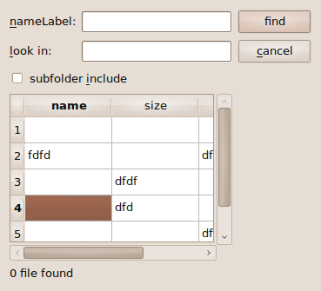
Grid Layout(QGridLayout)
A QGridLayout lays out widgets in a two-dimensional grid. Widgets can occupy multiple cells. E.g

Slide 21
QLayout Notes/Suggest
1)Use layout as more as you can in UI, especially for Mobile platform program, because in the phone, it have portrait and landscape modes.
2)When you set a layout, use QSpacerItem(Provides blank space in a layout) adjust your layout if you necessary.
3)When you layout for a UI, suggest to reference the Object Inspector that in Qt Designer.
4)If it has Breake Layout icon in Object Inspector, usually means layout have problems, especially for Mobile phone program.
5) If we need to change size for widget(e.g. QTextEdit) that in layout, right click the control and choose Size Constraints change the size of the widget in Qt Designer.
Noes: Fromm point 2 to 5 are have diagrams in next few pages one by one.

Slide 22
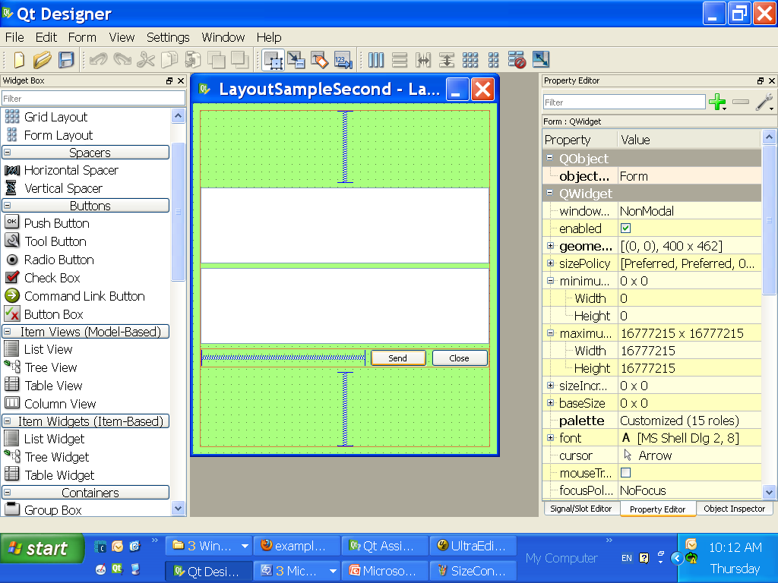
QSpacerItem illustration
QSpacerItem

Slide 23
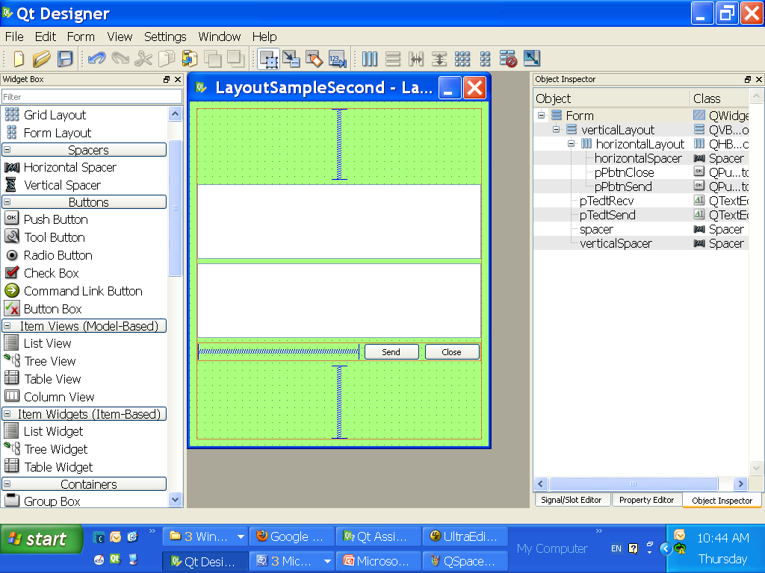
Object Inspector illustration
Object Inspector

Slide 24
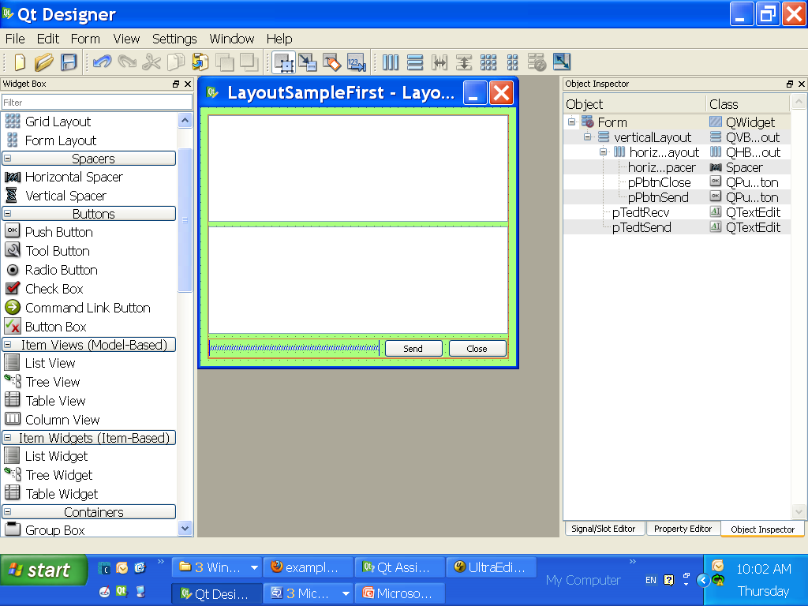
Break Layout Icon illustration
Break Layout icon shouldn’t appear in Object Inspector.

Slide 25
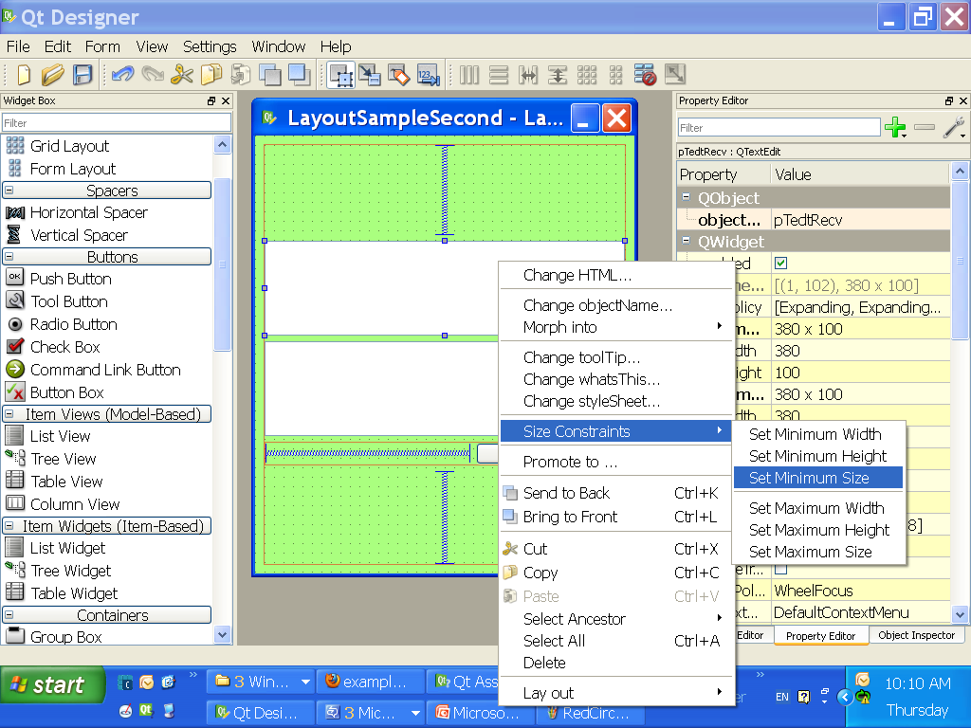
Size Constraints illustration

Slide 26
Notes/Example
1) This slides is the 1.0 version, and the changed new version will be uploaded into \\cnchfs301\projects$\Qt\Presentation
2) Simple layout management example is in \\cnchfs301\projects$\Qt\Examples\Qt Widgets and Layout Samples\ LayoutSampleFirst.ui
3)Add QSpacerItem into layout example is in \\cnchfs301\projects$\Qt\Examples\Qt Widgets and Layout Samples\ LayoutSampleSecond.ui

Slide 27
Thank you!

